Slide 1
ME 203 Introduction to MATLAB
‹#›

Slide 2
Basic Two Dimensional Plots
Consider this x-y data
time, sec | Distance, Ft
0 | 0
2 | 0.33
4 | 4.13
6 | 6.29
8 | 6.85
10 | 11.19
12 | 13.19
14 | 13.96
16 | 16.33
18 | 18.17
Time is the independent variable and distance is the dependent variable

Slide 3
Define x and y vectors and call the plot function
clc; clear; format compact
x = [0:2:18];
% x = linspace(0,18,10);
y = [0, 0.33, 4.13, 6.29, 6.85, ...
11.19, 13.19, 13.96, 16.33, ...
18.77];
plot(x,y)
time, sec | Distance, Ft
0 | 0
2 | 0.33
4 | 4.13
6 | 6.29
8 | 6.85
10 | 11.19
12 | 13.19
14 | 13.96
16 | 16.33
18 | 18.17
You can use any variable name that is convenient for the dependent and independent variables

Slide 4
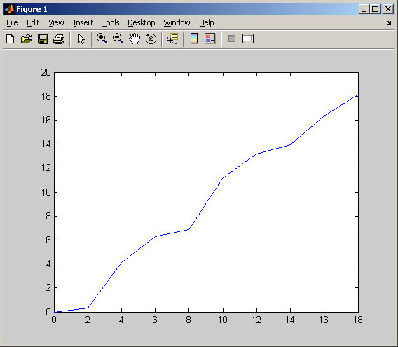
Results

Slide 5
Add title, labels, and a grid
clc; clear; format compact
x = [0:2:18];
% x = linspace(0,18,10);
y = [0, 0.33, 4.13, 6.29, 6.85, ...
11.19, 13.19, 13.96, 16.33, ...
18.77];
plot(x,y)
title('Lab Experiment')
xlabel('Time, s')
ylabel('Distance, ft')
grid on

Slide 6
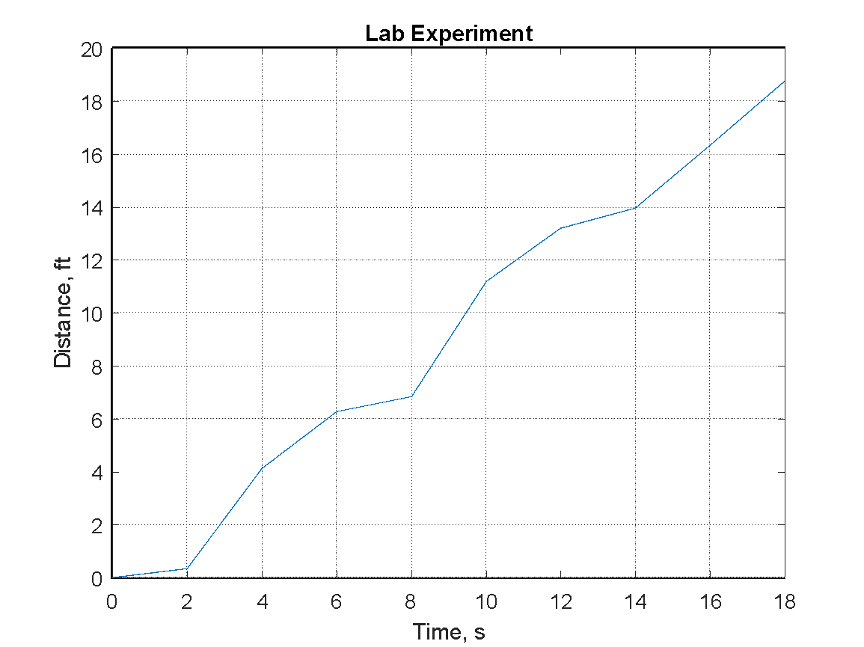
Results

Slide 7
Example
Given w = sin(z)
a) Plot w over the range 0 to 10 with a resolution on 0.1
b) Determine the 25th value of w
c) What is the index value of the first maximum

Slide 8
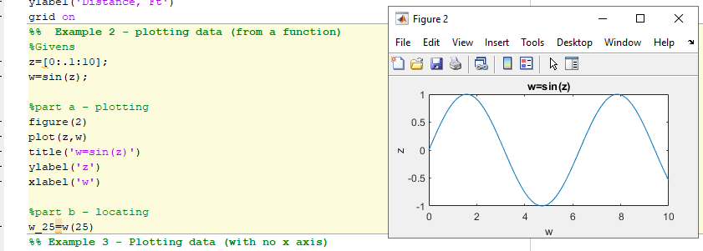

Slide 9
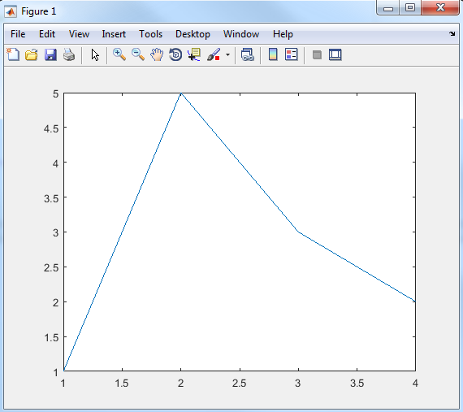
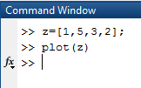
Variations
If you use the plot command with a single matrix, MATLAB plots the values versus the index number
Usually this type of data is plotted on a bar graph
When plotted on an x-y grid, it is often called a line graph
X coordinate (index number) | Z
1 | 1
2 | 5
3 | 3
4 | 2

Slide 10
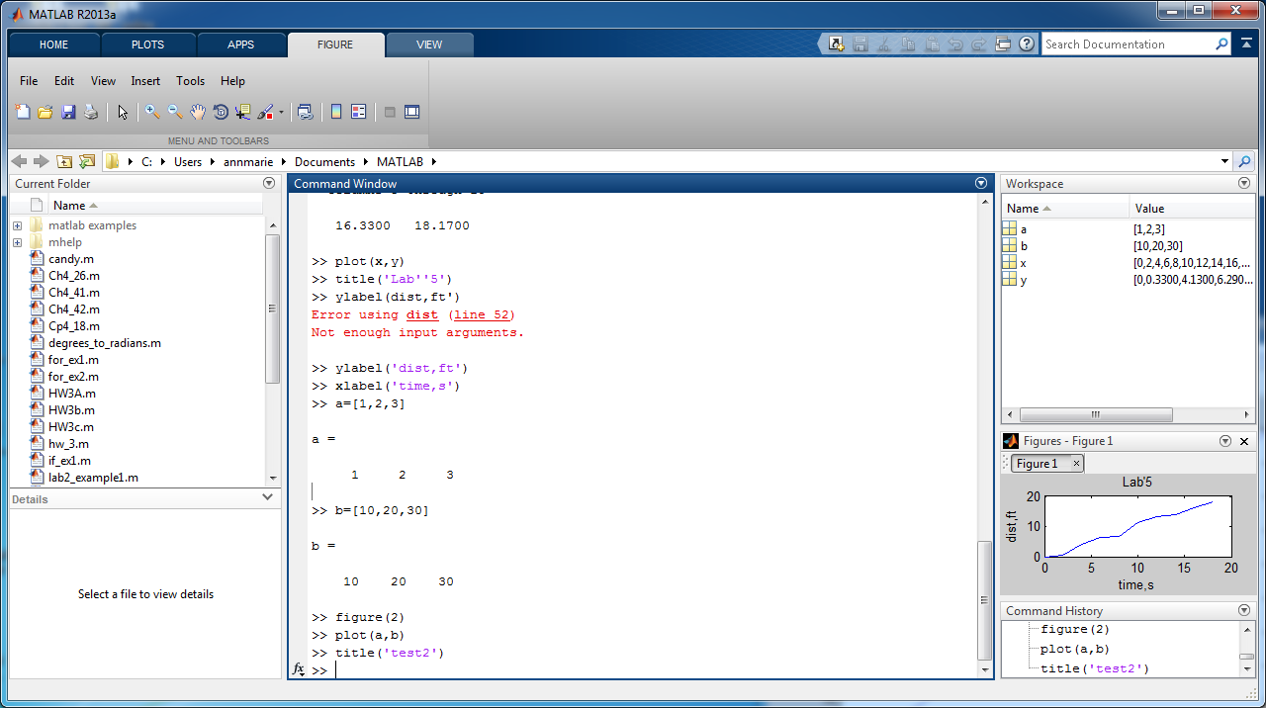
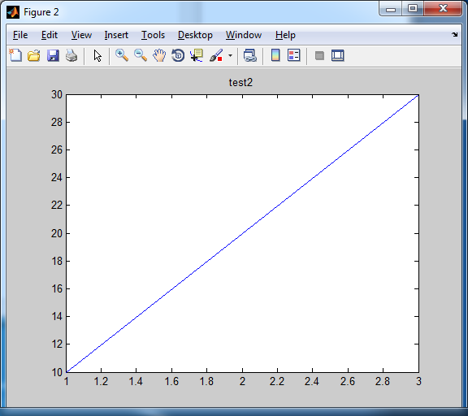
Creating multiple plots
MATLAB overwrites the figure window every time you request a new plot
To open a new figure window use the figure function – for example figure(2)

Slide 11
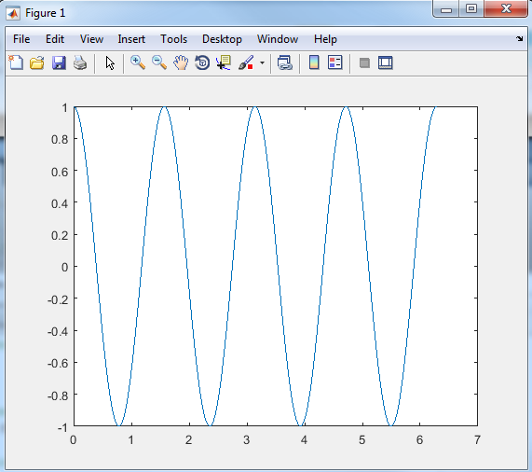
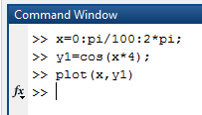
Plots with multiple lines:
hold on function
Freezes the current plot, so that an additional plot can be overlaid
The first plot is drawn in blue

Slide 12
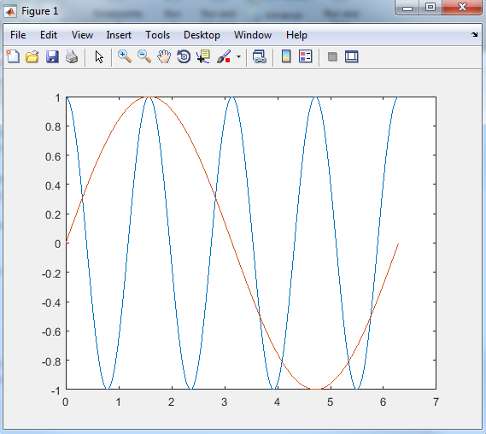
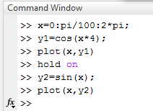
The hold on command freezes the plot
The second plot is drawn in red
To unfreeze the plot, use the hold off command

Slide 13
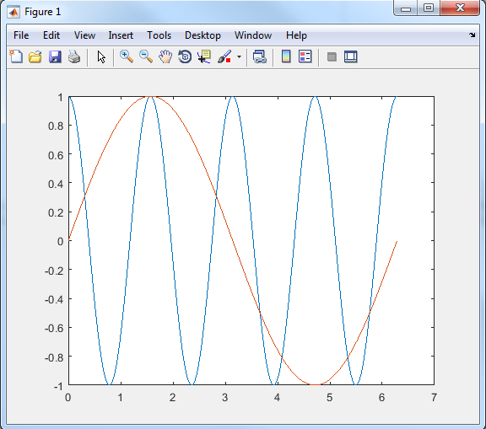
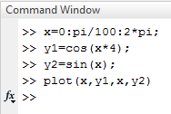
Creating multiple lines on a single graph with one command
Each set of ordered pairs will produce a new line

Slide 14
If you want to create multiple plots, all with the same x value you can…
Use alternating sets of ordered pairs
plot(x, y1, x, y2, x, y3, x, y4)
Or group the y values into a matrix
z=[y1; y2; y3; y4]
plot(x,z)

Slide 15
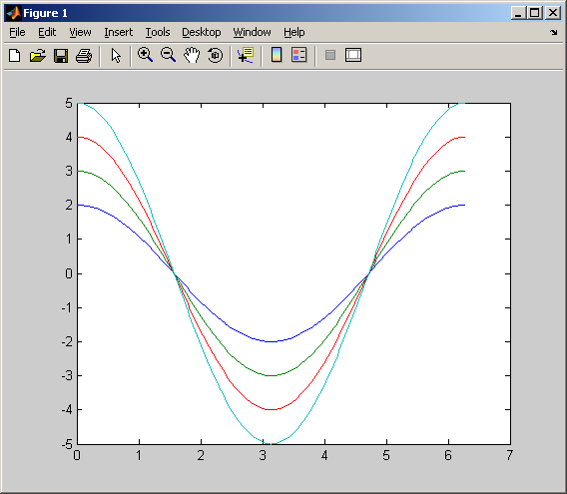
x = [0 : pi/100 : 2*pi];
y1 = cos(x)*2;
y2 = cos(x)*3;
y3 = cos(x)*4;
y4 = cos(x)*5;
Plot (x, y1, x, y2, x, y3, x, y4)
Alternating sets of ordered pairs

Slide 16
x = [0 : pi/100 : 2*pi];
y1 = cos(x)*2;
y2 = cos(x)*3;
y3 = cos(x)*4;
y4 = cos(x)*5;
z = [y1; y2; y3; y4];
plot(x, z)
OR use a Matrix of Y values

Slide 17
Line, Color and Mark Style
You can change the appearance of your plots by selecting user defined
line styles
color
mark styles
Try using help plot for a list of available styles

Slide 18
Available choices
Table 5. 2 Line, Mark and Color Options
Line Type | Indicator | Point Type | Indicator | Color | Indicator
solid | - | point | . | blue | b
dotted | : | circle | o | green | g
dash-dot | -. | x-mark | x | red | r
dashed | -- | plus | + | cyan | c
 |  | star | * | magenta | m
 |  | square | s | yellow | y
 |  | diamond | d | black | k
 |  | triangle down | v
 |  | triangle up | ^
 |  | triangle left | <
 |  | triangle right | >
 |  | pentagram | p
 |  | hexagram | h

Slide 19
Specify your choices in a string
Table 5. 2 Line, Mark and Color Options
Line Type | Indicator | Point Type | Indicator | Color | Indicator
solid | - | point | . | blue | b
dotted | : | circle | o | green | g
dash-dot | -. | x-mark | x | red | r
dashed | -- | plus | + | cyan | c
 |  | star | * | magenta | m
 |  | square | s | yellow | y
 |  | diamond | d | black | k
For example
plot(x,y,':ok')
if you don’t specify style, a default is used
Line type – solid
Point type – none
Color – blue

Slide 20
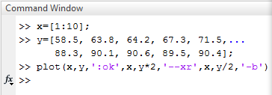
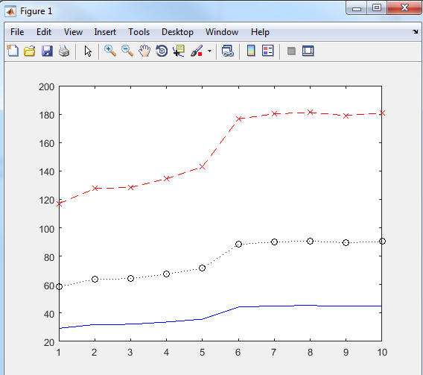
specify the drawing parameters for each line after the ordered pairs that define the line
Notes:
x=[1:10];
y=[58.5,63.8,64.2,67.3,71.5,88.3,90.1,90.6,89.5,90.4];

Slide 21
Axis scaling
MATLAB automatically scales each plot to completely fill the graph
If you want to specify a different axis – use the axis command
axis([xmin,xmax,ymin,ymax])
* Notice you need () and []
Lets change the axes on the graph we just looked at

Slide 22
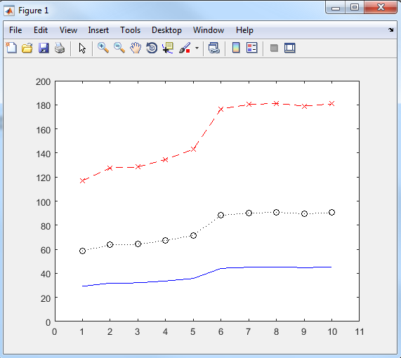
Use the axis function to override the automatic scaling

Slide 23
Additional Annotations
You can also add
legends
textbox

Slide 24
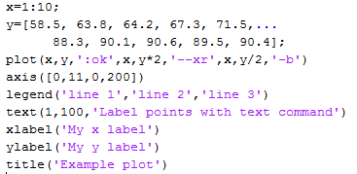
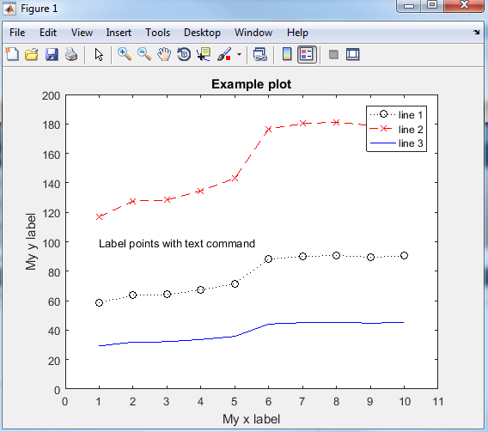
Update legend to reflect data such as changing line 1 to distance, and line 2 to time
text(X,Y,'string') adds the text in the quotes to location (X,Y) on the current axes.
gtext('string')
After you run your program, click on your graph to place text

Slide 25
Improving your labels
You can use Greek letters in your labels by putting a backslash (\) before the name of the letter.
For example:
title(‘\alpha \beta \gamma’)
creates the plot title
α β γ
Reference- https://www.mathworks.com/help/matlab/creating_plots/greek-letters-and-special-characters-in-graph-text.html
Notes:
https://www.mathworks.com/help/matlab/creating_plots/greek-letters-and-special-characters-in-graph-text.html

Slide 26
Superscripts and Subscripts
To create a superscript use the modifier ^{ }
For example:
title(‘x^{2}’)
Gives x²
To create a subscript use the modifier _{ }
For example:
title(‘x_{2}’)
Gives x₂

Slide 27
Subplots
The subplot command allows you to subdivide the graphing window into a grid of m rows and n columns
subplot(m,n,p)
rows
columns
location

Slide 28
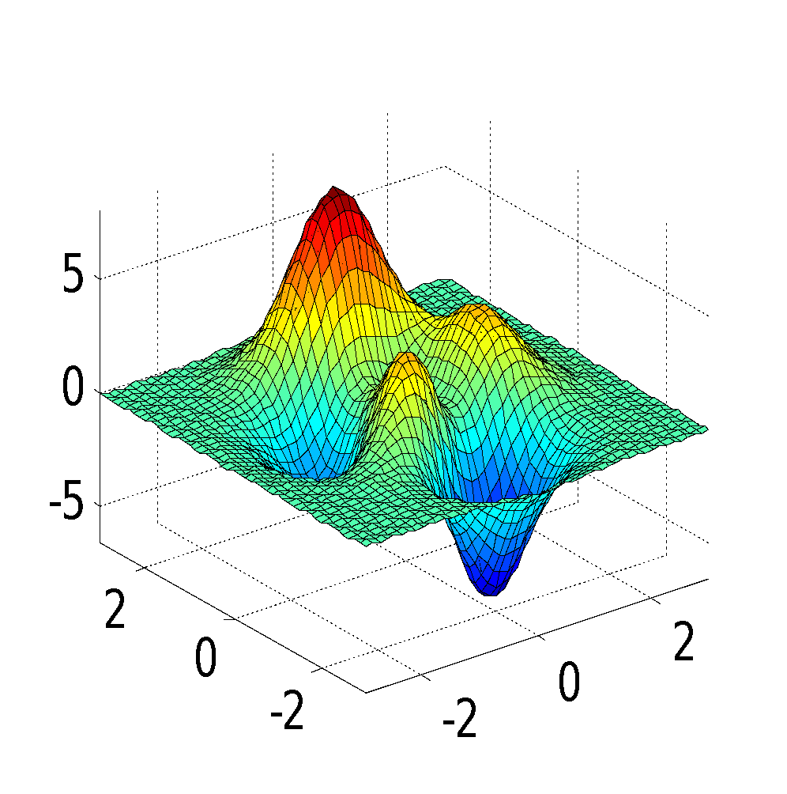
subplot(2,2,1)
2 columns
1
2
4 Locations
2 rows
3
4

Slide 29
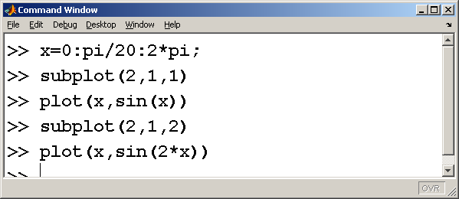
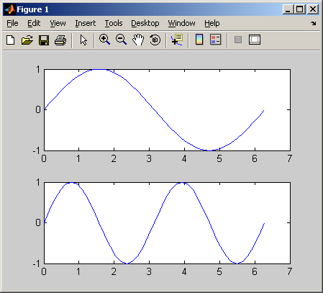
2 rows and 1 column

Slide 30
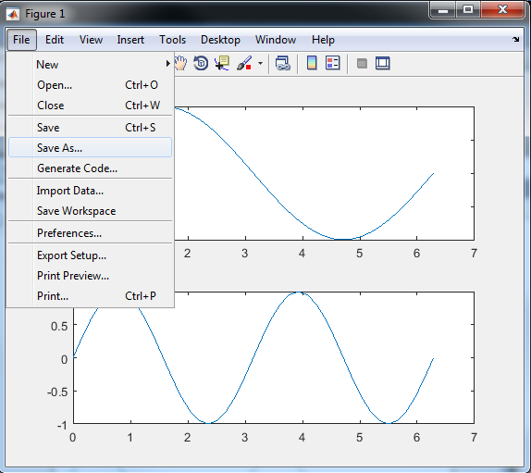
Saving your plots
Rerun your M-file to recreate a plot
Save the figure from File menu using the Save As… option
You’ll be presented with several choices of file format such as
jpeg
fig (MATLAB figure) etc.

Slide 31
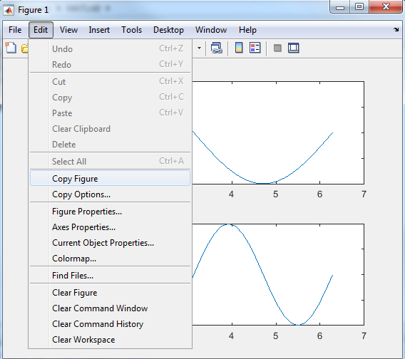
Saving your plots
To copy the figure: from the Edit menu select Copy Figure – then paste it into another document

Slide 32
Plots of Complex Arrays
If the input to the plot command is a single array of complex numbers, MATLAB plots the real component on the x-axis and the imaginary component on the y-axis

Slide 33

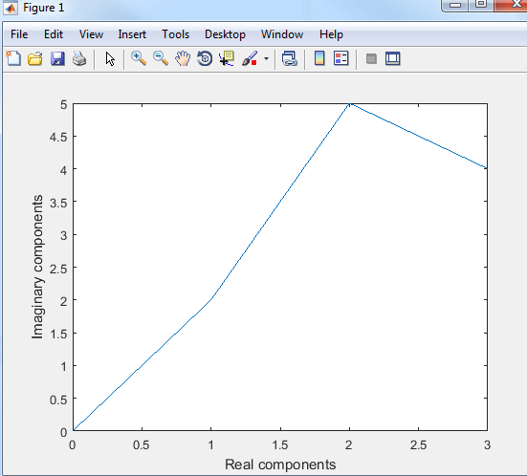

Slide 34
Multiple arrays of complex numbers
If you try to use two arrays of complex numbers in the plot function, the imaginary components are ignored

Slide 35
